Slide 1

ST. Vincent Pallotti College of Engineering and Technology
DEPARTMENT OF INFORMATION TECHNOLOGY
Academic Year 2019-20
Major Project Review Seminar on:
ENERGY MONITORING SYSTEM(EMS) (For Industrial Automation)
Project Member:
Tarun Pathe
Pawan Ukey
Darshan Dhone

Slide 2
Introduction - What is Energy Audit ?
As the energy audit is need of industries in order to save unnecessary energy consumption and to know the exact requirement of industry, hence the proposed system is taking this development at next level by enhancing the term IoT (internet of things) for industrial remote energy parameter monitoring system.
The objective of energy audit is to identify the end use of energy in industry, and this feasibility study leads to implementation of an energy management program.
Notes:
Hello everyone, before starting the explanation of the project and it’s objectives let’s first discuss something about energy audit. As we all know energy audit is need of industries in order to save unnecessary energy consumption and to know the exact requirement of industry, hence the proposed system is taking this development at next level by enhancing the term IoT (internet of things) for industrial remote energy parameter monitoring system. The main objective of energy audit is to identify the tentative consumption of energy in industry, and this feasibility study leading to implementation of an energy management program.

Slide 3
Introduction – What is remote monitoring ?
Remote monitoring of different industries sensors, machineries, energy or the power panels are the most demanding products and many organizations are working on it.
Up till now we have seen only computers, mobiles and very few devices are connected to internet directly.
Still many embedded system or the devices needs to redesign so that they can communicate with other world through internet.
In simple world we called it as a IoT
Notes:
Now next discussion is about remote monitoring system where remote monitoring of different industries sensors, machineries, energy or the power panels are the most demanding products and many organizations are working on it. Up till now we have seen only computers, mobiles and very few devices are connected to internet directly and Still many embedded system or the devices needs to redesign so that they can communicate with other world through internet and this is what we called as IoT the internet of things.

Slide 4
Objective
To design a microcontroller based or IoT based internet enabled remote data acquisition system for energy parameter monitoring.
To develop a web service for interaction between web application and microcontroller / IoT device
To implement centralized data gathering and management application.
To develop internet enabled graphical data analysis tool.
ANV Infotech Pvt. Ltd. is developing and manufacturing a IoT Based EMS for its clients and we are working as a interns for the company
Notes:
Combining the above stated discussion the main objective of the system is to design a microcontroller based or IoT based internet enabled remote data acquisition system for energy parameter monitoring. Another objective is to develop a web service for interaction between web application and microcontroller / IoT device. Once this done system will be having centralized data gathering and management application. Which allow users to analyze the gathered data using graphical analysis tools. This is an initiative by ANV Infotech Pvt. Ltd. who are developing and manufacturing a IoT Based EMS for their clients and we are working as a interns for the company.

Slide 5
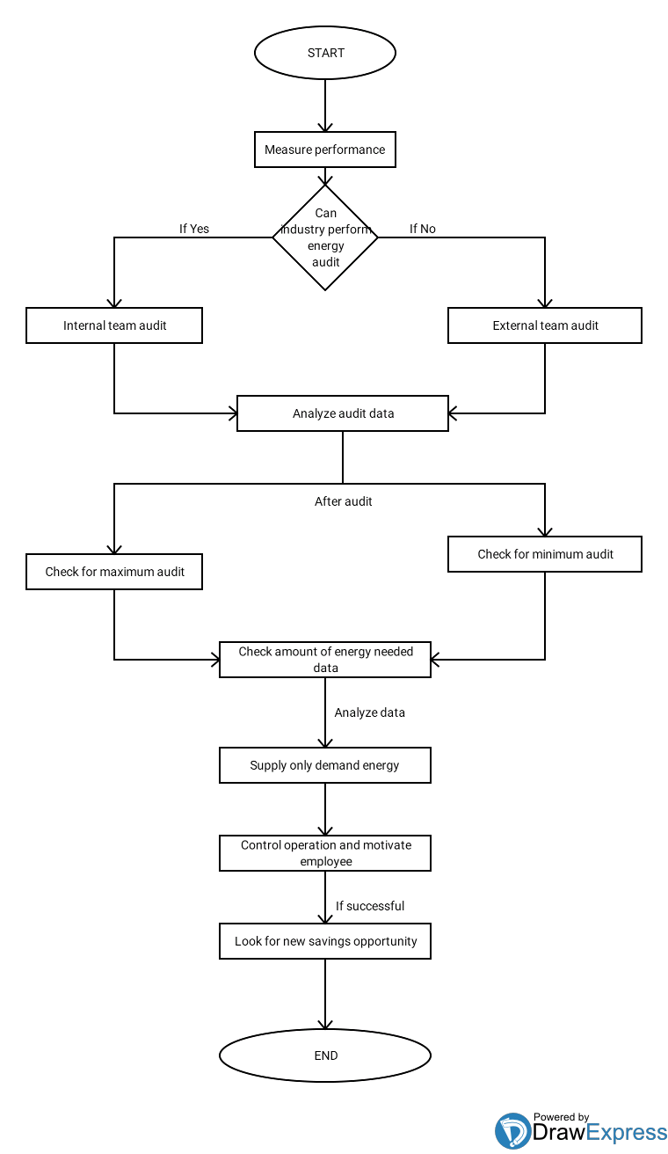

Slide 6
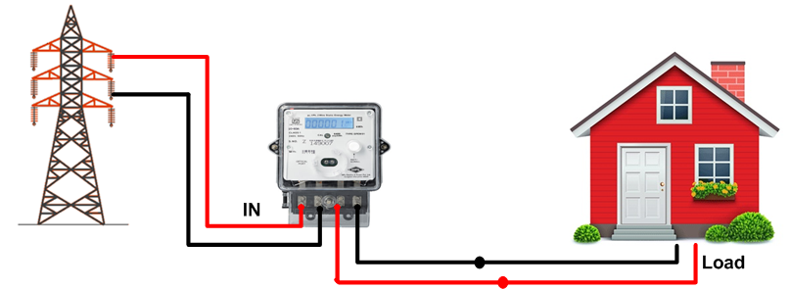
Proposed system
Notes:
Before going in details about the proposed system let’s first understand the standard metering and industrial smart meters. Above stated diagram show the typical implementation of the MSEB meter and these meters are only capable of showing incremental energy consumption by means of some digits only, but we can’t see exact load like voltage, current, power factor, etc. and not even the previous consumption details like daily usage, day time usage, night hours usage, etc. to solve this problem we have smart meter these meters are capable enough to show multiple parameter along with storing log of almost a month, but again this will raise a problem these meters can transmit this information to any other device and not this is feasible to note all reading manually periodically. So next we need to develop an IoT based device to read all the parameter from meter over MODBUS protocols and upload this information to IoT server so that using the web or mobile application user can see the energy parameter consumption graphically. Hence this is the exact scope of the work to develop the IoT based device, deploy IoT server and develop web application for data analysis.

Slide 7
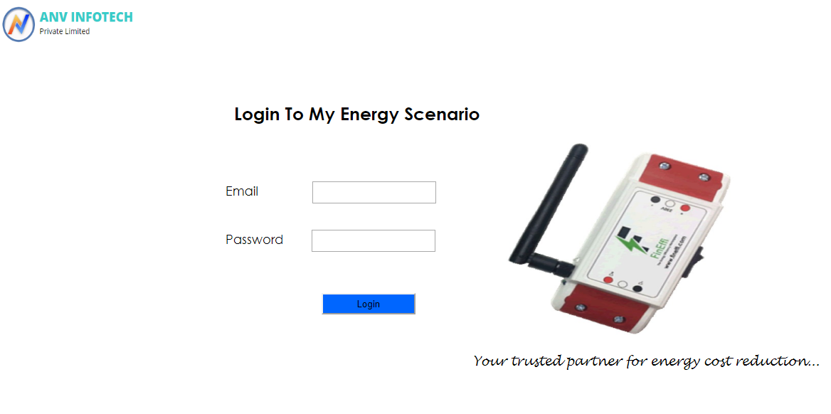
IMPLEMENTATION

Slide 8
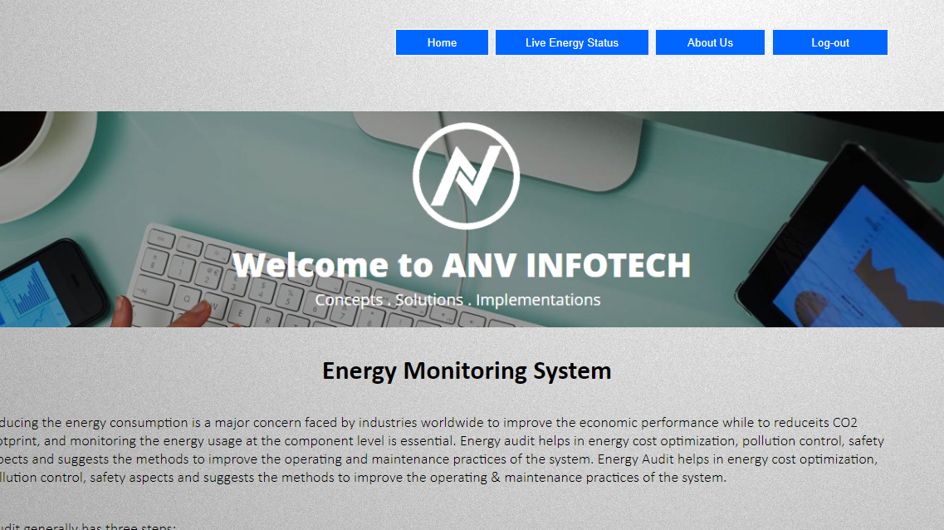
IMPLEMENTATION

Slide 9
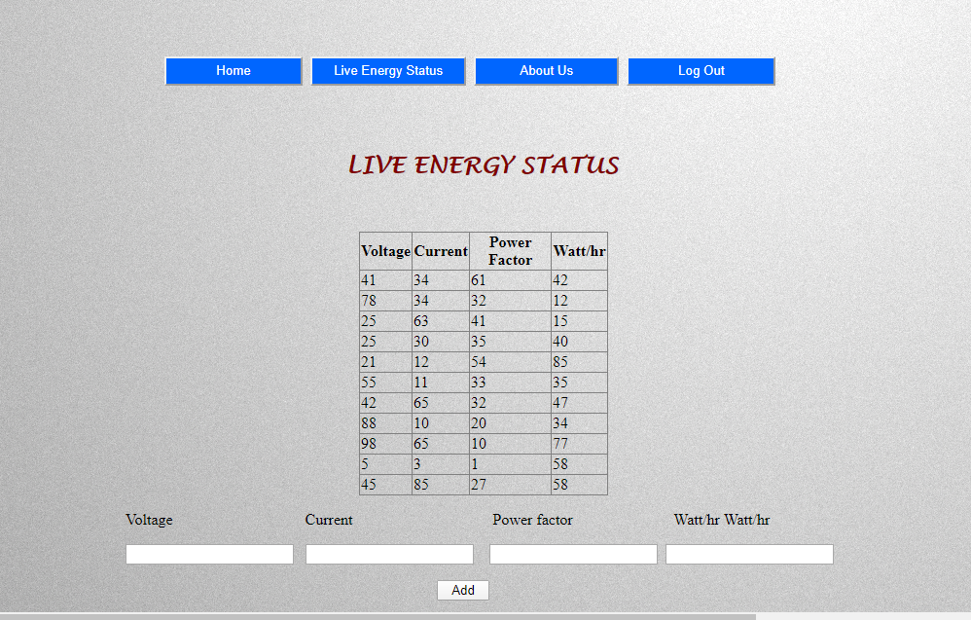
IMPLEMENTATION

Slide 10
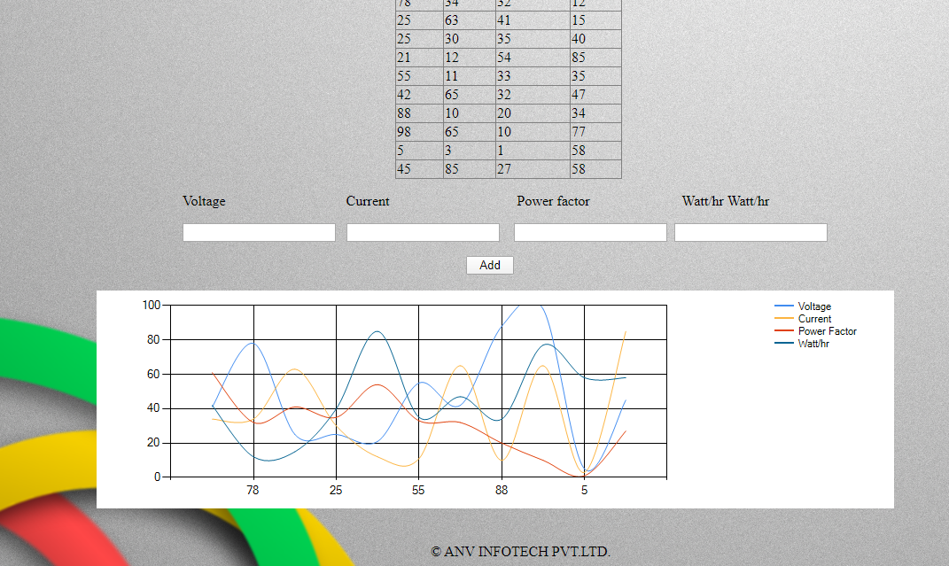
IMPLEMENTATION (Cont.)

Slide 11
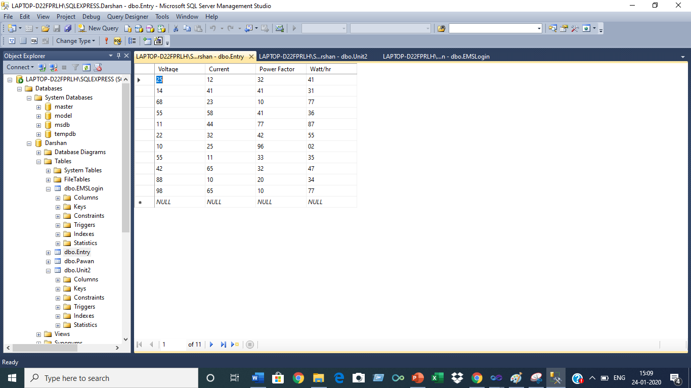
IMPLEMENTATION

Slide 12
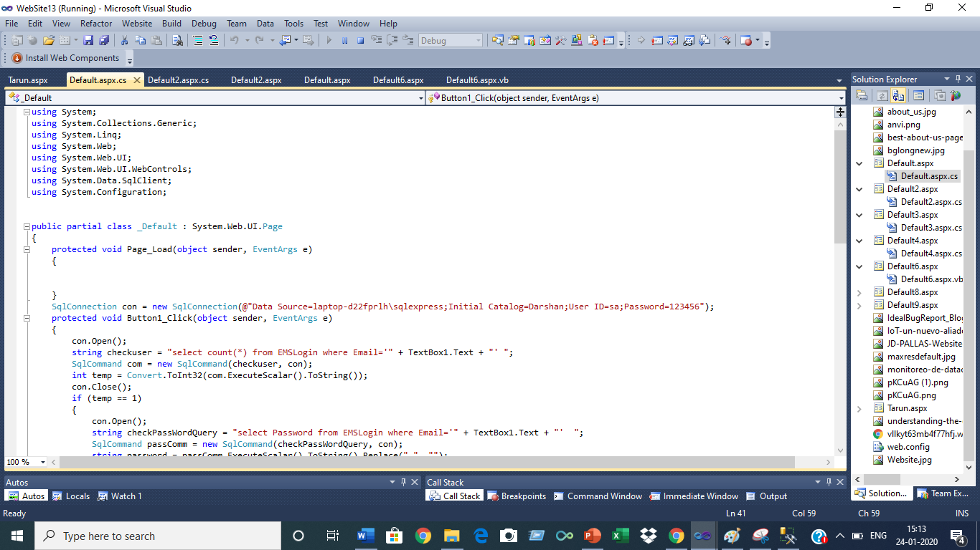
IMPLEMENTATION

Slide 13
Thank You.

